Slide 1
Demystifying Graph API and Service Now
Using a Service account, CrowdStrike and Ansible to glue it all together

Slide 2
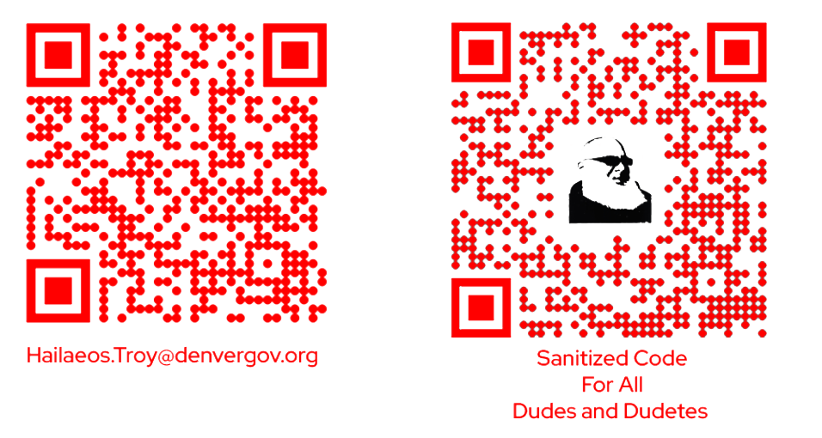
Hailaeos.Troy@DenverGov.org

Slide 3






Notes:
12 seasons at mcmurdo station with 1st being at the southpole

Slide 4
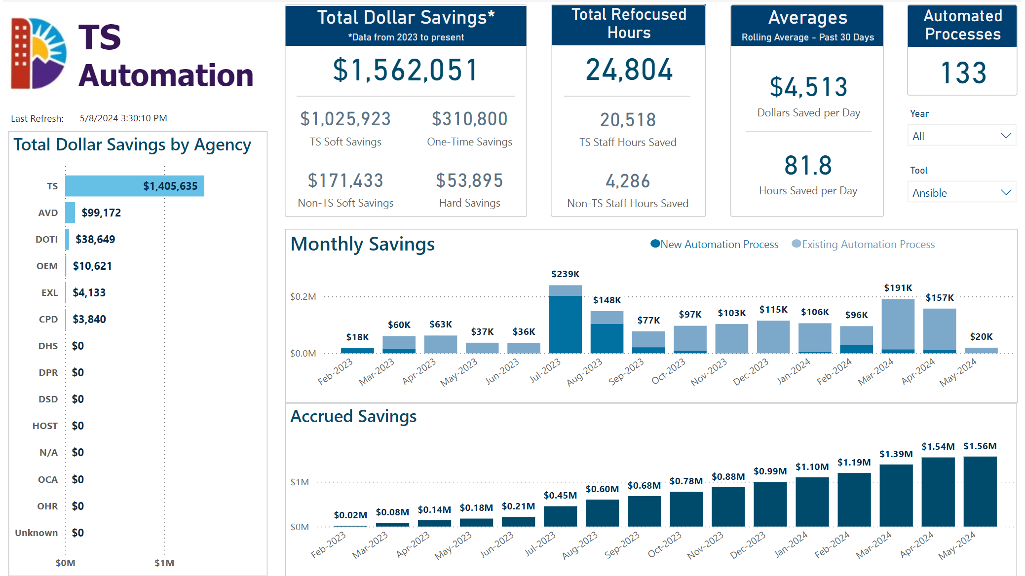

Slide 5
50,000 foot view
Step 1
The Problem
CrowdStike sends an email to a service account, each email is a user that is using a password that is on a known compromise list. Like “password123”
Ansible once an hour will do the following:
Grab any new mail and process them (Graph API)
Ansible then will match the account and send a notification and force a password change (A D)
Move all the messages that were processed to the Archive folder (Graph API)
Unmatched accounts will get a ServiceNow task assigned to Security (Service Now)

Slide 6
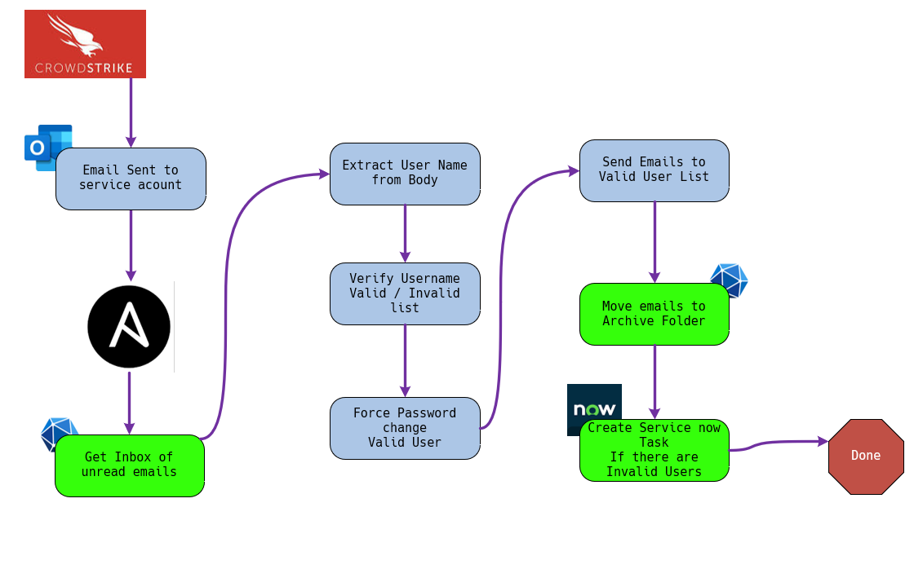
Step 1
The Problem

Slide 7
25,000 foot view
Groundwork
Pieces to get the job done
Get with the Azure Admin and create an Enterprise application and get the Delegated and Application permissions you need. (in my case I have the needed permissions)
Put your app secrets in your Ansible vault or your favorite secure location like Secret Server
Get with the ServiceNow folks get access to your Dev/Test/Sandbox environment and permission to access the Rest API Explorer its your friend, like me.
Get a ServiceNow service account setup with the correct permissions to create TASK Bonus points for getting impersonate rights in Dev/Test/Sandbox or full Admin. Trust me it helps

Slide 8
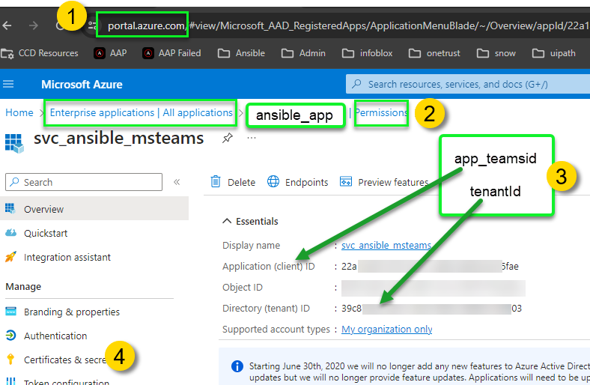
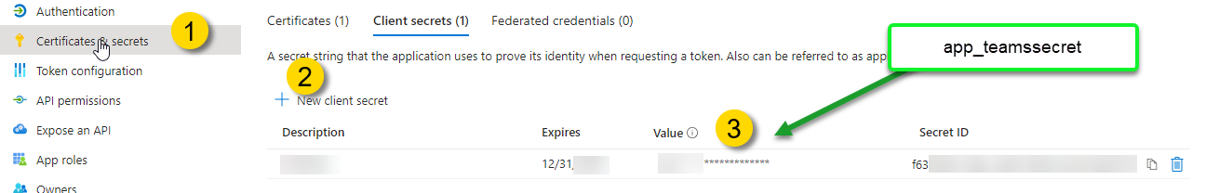
Down in the weeds
This is where you need your Azure Admin
Graph API task pieces
Notes:
1st things first we need an application with the right permissions

Slide 9
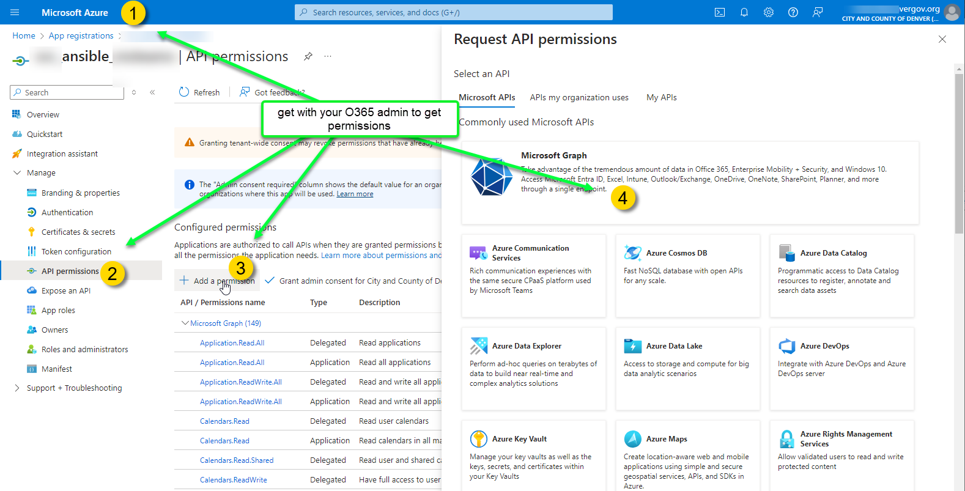
Down in the weeds
This is where you need your Azure Admin
Graph API task pieces
Notes:
1st things first we need an application with the right permissions

Slide 10

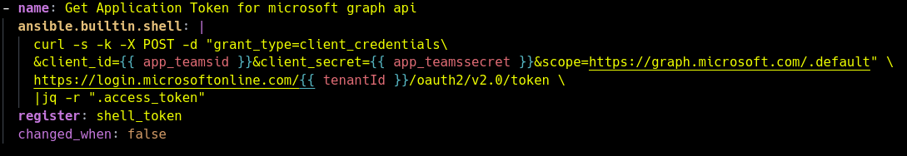
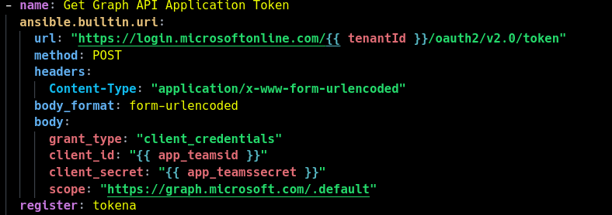
Get a Token
Demystify Microsoft Graph API
To or to ansible.builtin.uri
a
Notes:
Talk about azure app token encryption certificates and secrets

Slide 11
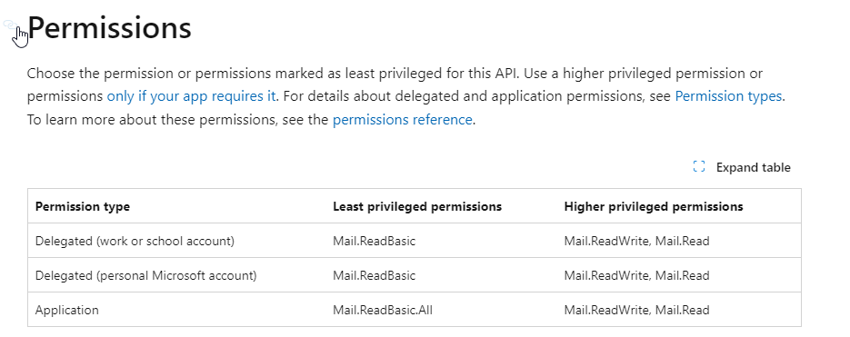
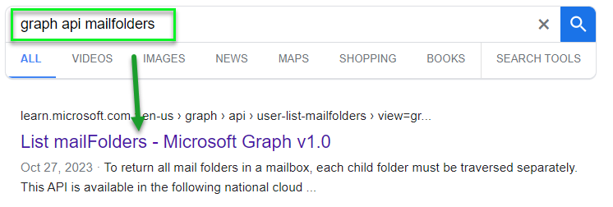
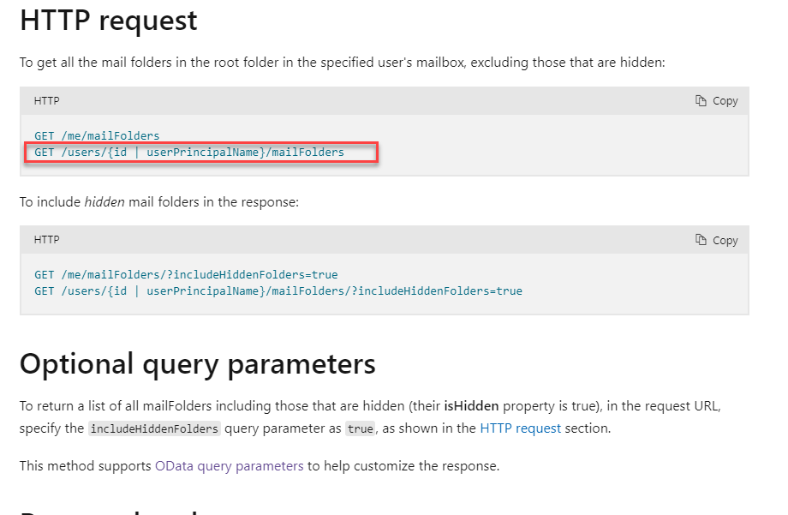
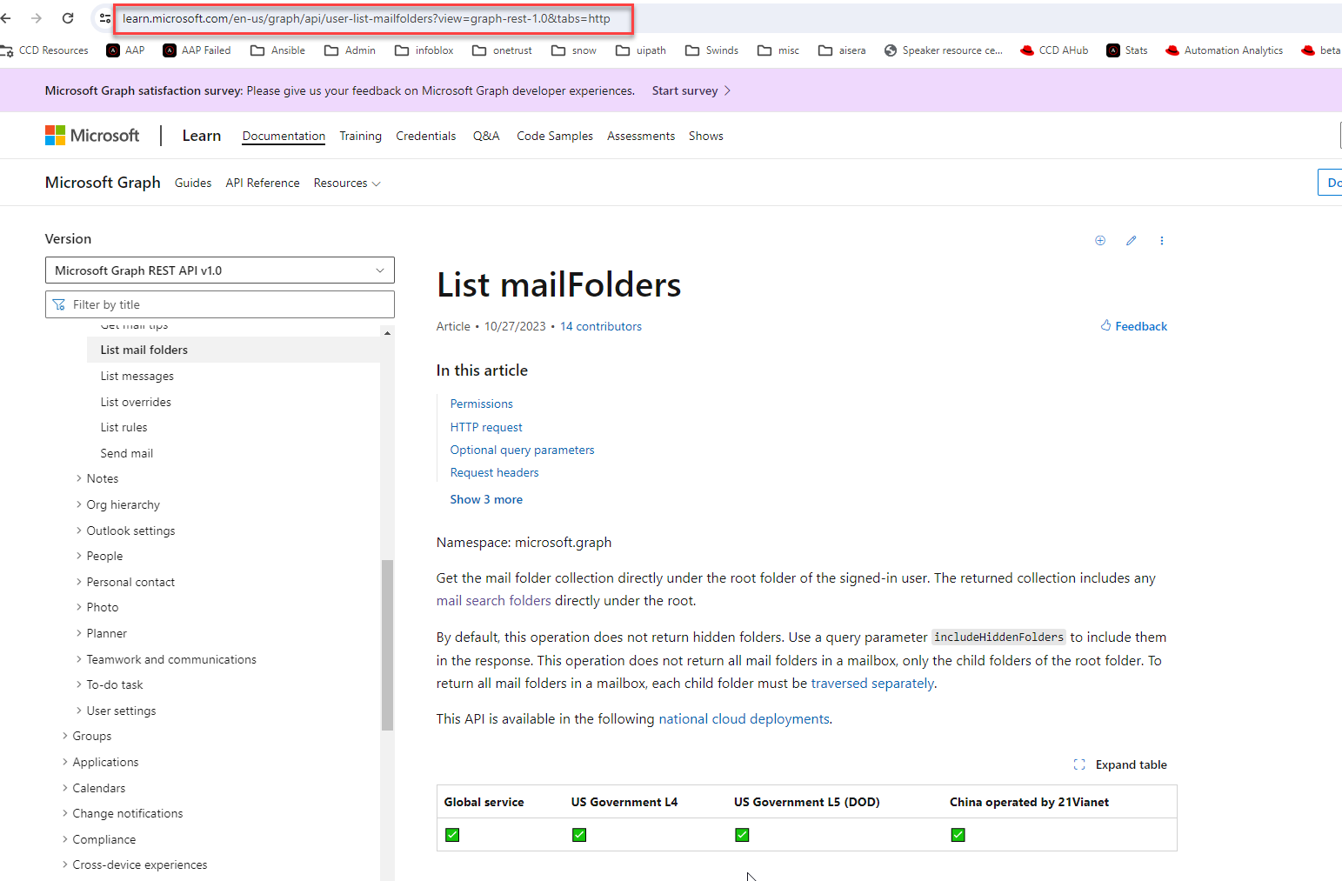
Microsoft Graph API

Slide 12
Get the root folders of the mail account
Demystify Microsoft Graph API
ansible.builtin.uri
Notes:
Green is the meat the yellow is for debugging
Talk about the json query

Slide 13
Get the root folders of the mail account
Demystify Microsoft Graph API
ansible.builtin.uri
Notes:
Green is the meat the yellow is for debugging
Talk about the json query

Slide 14
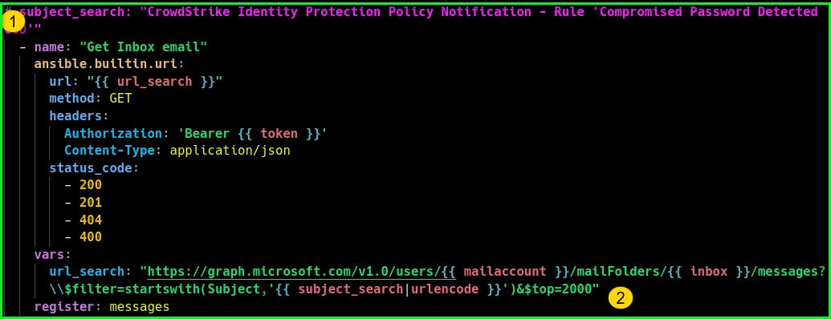
Get the root folders of the mail account
Demystify Microsoft Graph API
ansible.builtin.uri
The reason behind using $top=2000 is because I am lazy, I didn’t want to loop using the @odata.nextLink but if you do wind up having to do pagination Microsoft style this is now you do it
- set_fact: nextpage: “graphapidataresult.json['@odata.nextLink’]”
Notes:
Green is the meat the yellow is for debugging
Talk about the json query

Slide 15
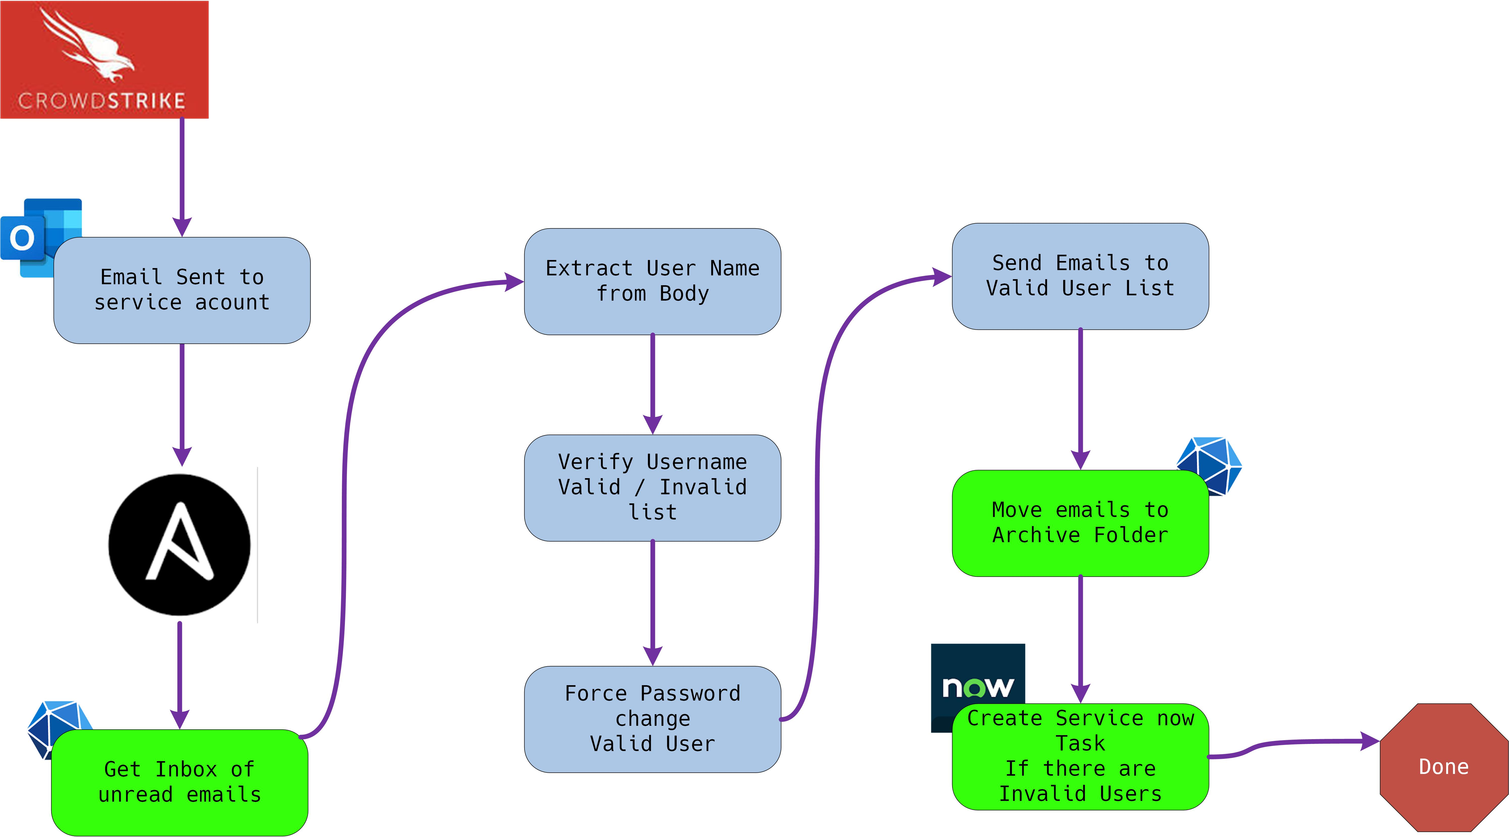
Mark the messages read and move them to the archive folder
Bonus points if you guess the year I started using Visio, clue take a look at the beard

Slide 16
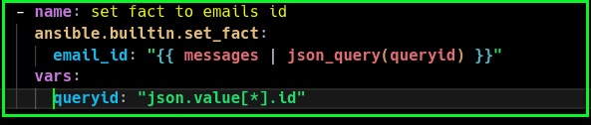
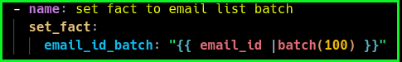
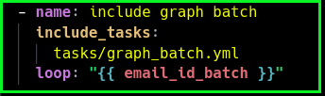
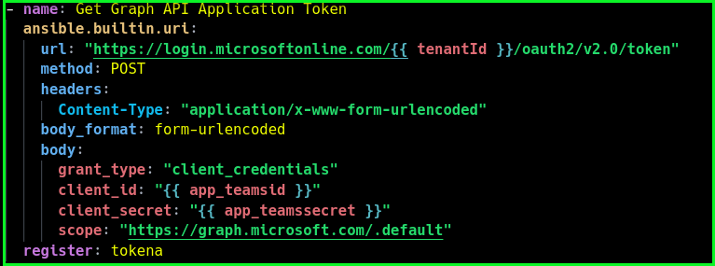
Mark messages read and move to Archive folder
Demystify Microsoft Graph API
Set a fact to the email id’s but do it as a batch of 100 messages to avoid a graph timeout
1
2
3
4
Notes:
Green is the meat the yellow is for debugging
Talk about the json query

Slide 17
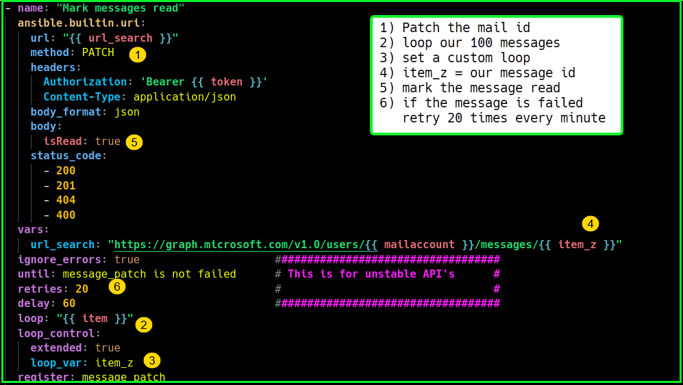
Mark messages read and move to Archive folder
Demystify Microsoft Graph API
Patch the mail record and mark it read
Notes:
Green is the meat the yellow is for debugging
Talk about the json query

Slide 18
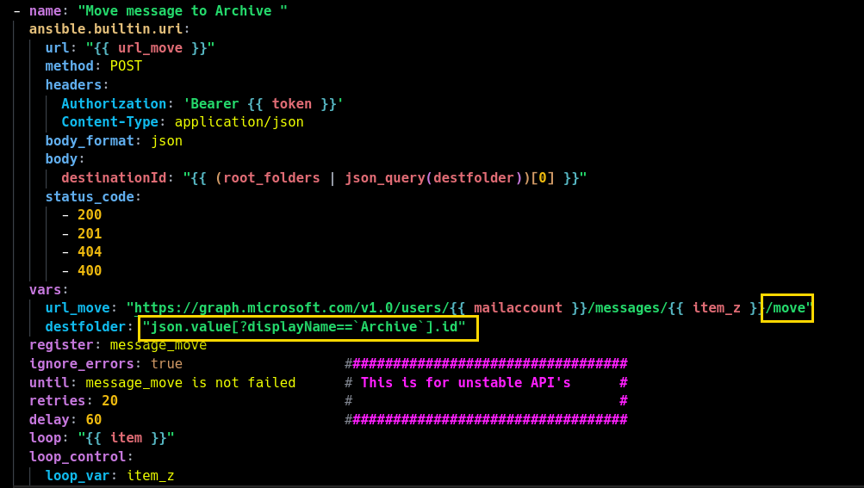
Mark messages read and move to Archive folder
Demystify Microsoft Graph API
Move the message now
Notes:
Green is the meat the yellow is for debugging
Talk about the json query

Slide 19
1,000 foot view
Diagram the issue
Lay it out, use your favorite diagram program I use Visio
Bonus points if you guess the year I started using Visio, clue take a look at the beard

Slide 20
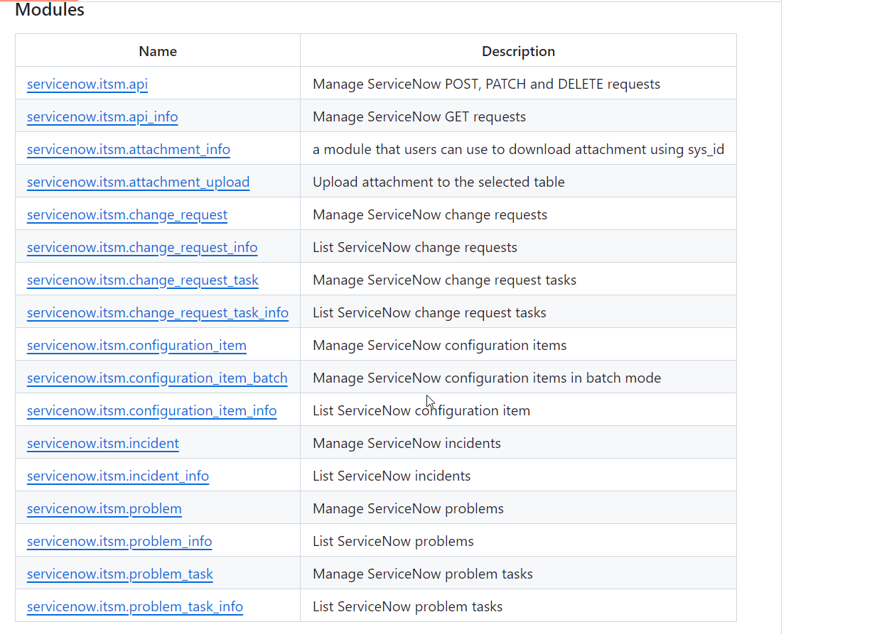
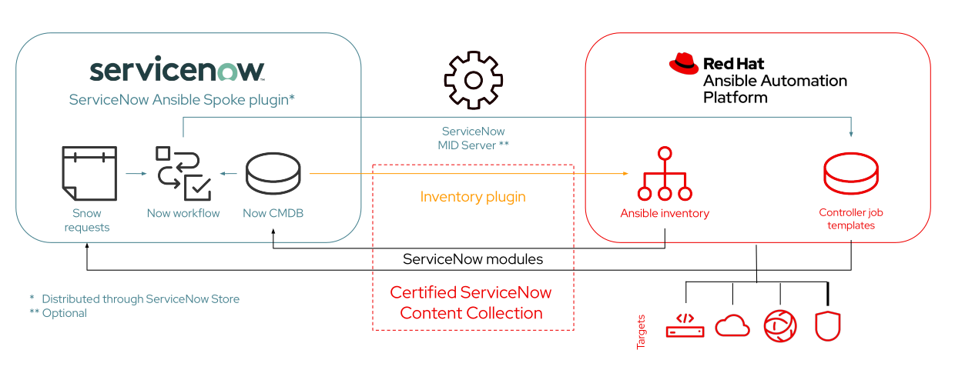
ServiceNow, SNOW
Demystifying ServiceNow
servicenow.itsm vs. ansible.builtin.uri
ITSM

Slide 21
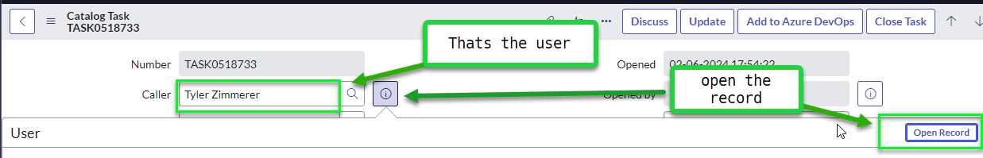
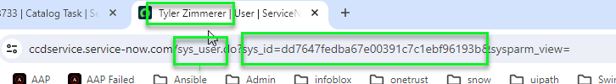
ServiceNow – Its in front of you just Look
Demystifying ServiceNow
1
2
3
4

Slide 22
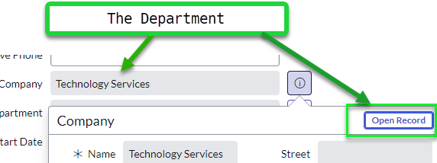
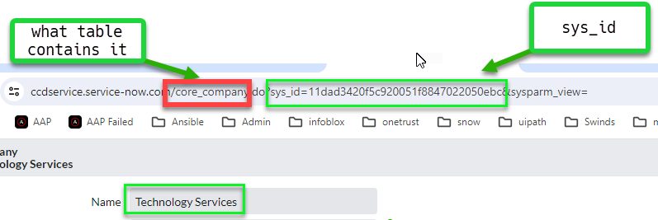
ServiceNow – Its in front of you just Look
Demystifying ServiceNow

Slide 23
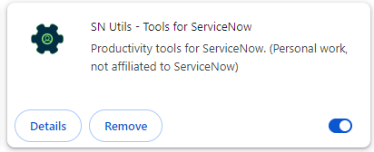
ServiceNow – There is a tool
Demystifying ServiceNow

Slide 24
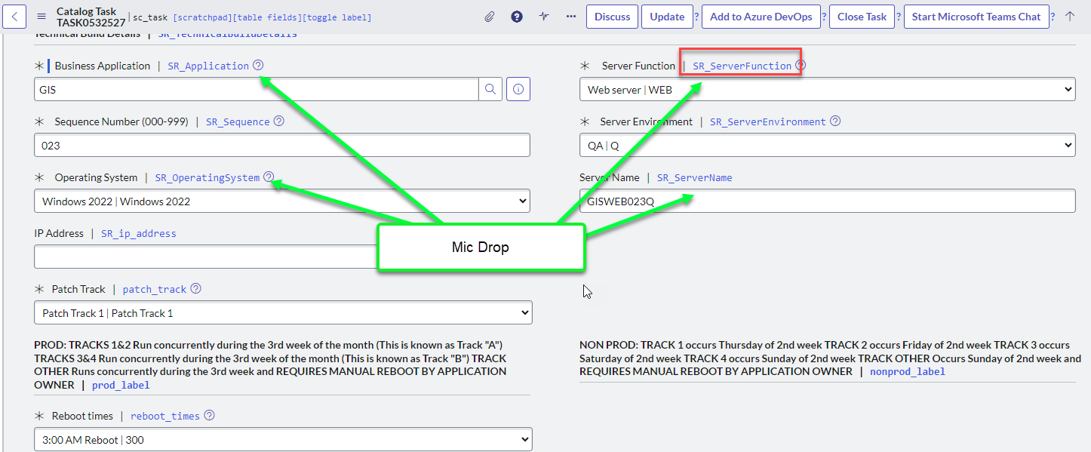
ServiceNow – There is a tool
Demystifying ServiceNow

Slide 25
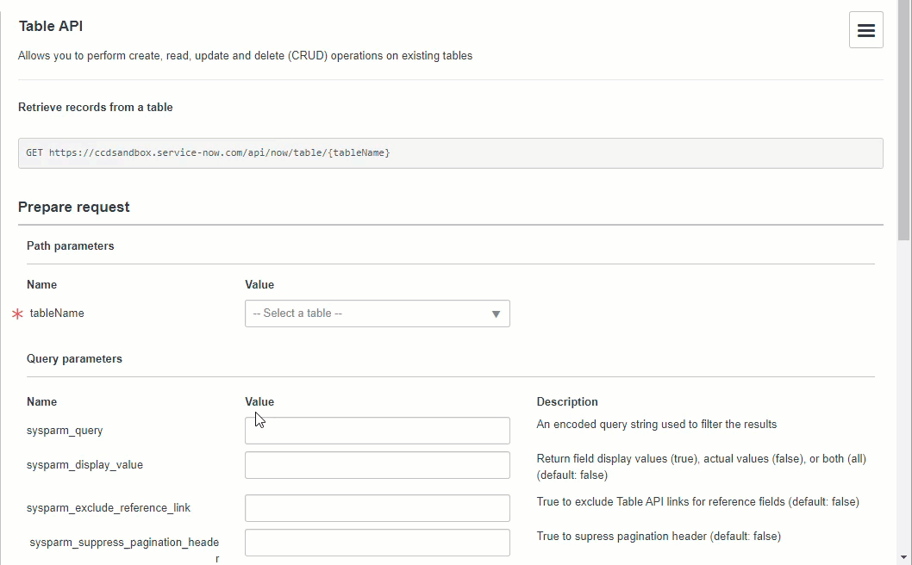
ServiceNow – Rest API Explorer – get a user
Demystifying ServiceNow

Slide 26
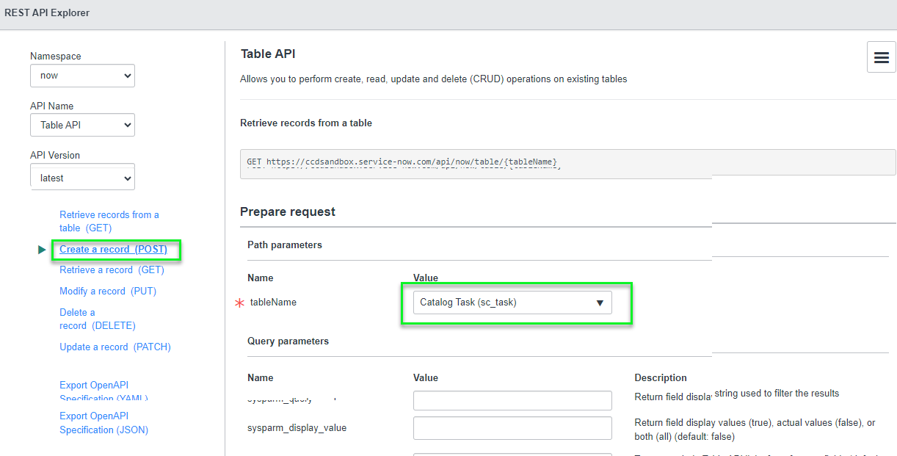
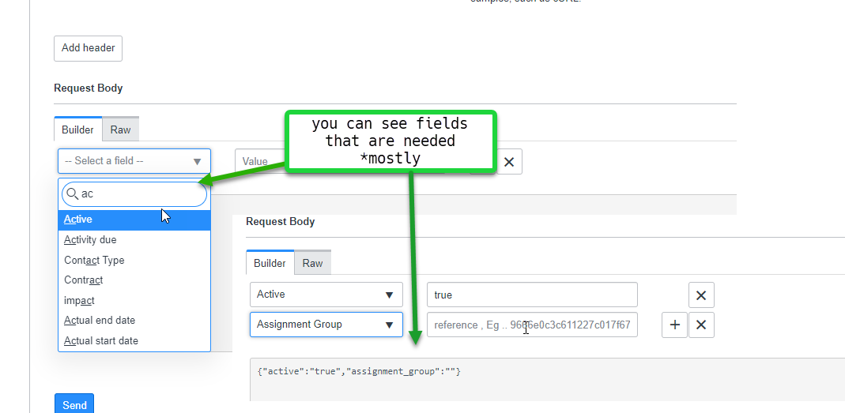
ServiceNow – Rest API Explorer
Demystifying ServiceNow

Slide 27
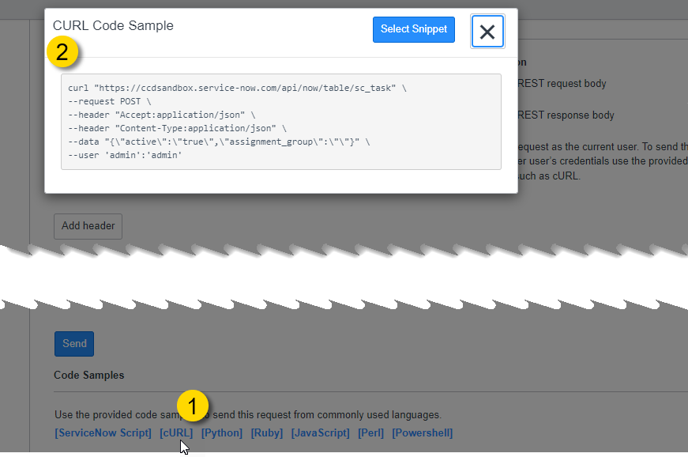
ServiceNow – Rest API Explorer
Demystifying ServiceNow

Slide 28
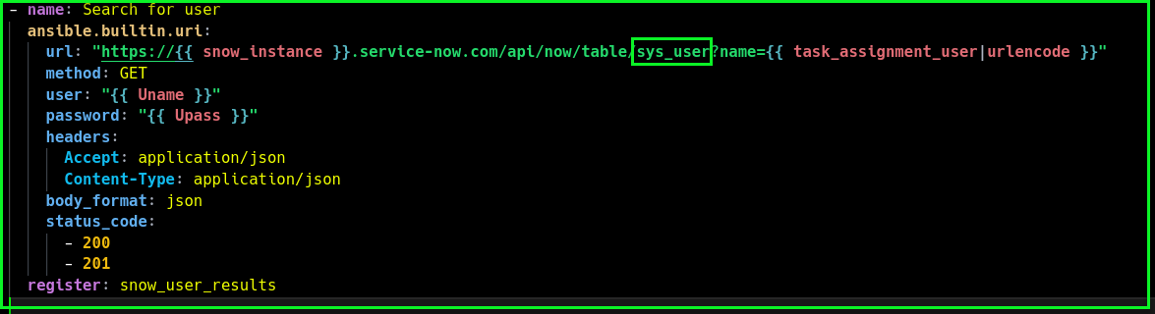
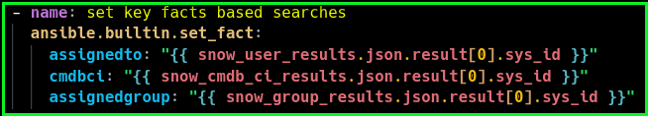
ServiceNow – uri get user
Demystifying ServiceNow
1
2
3

Slide 29
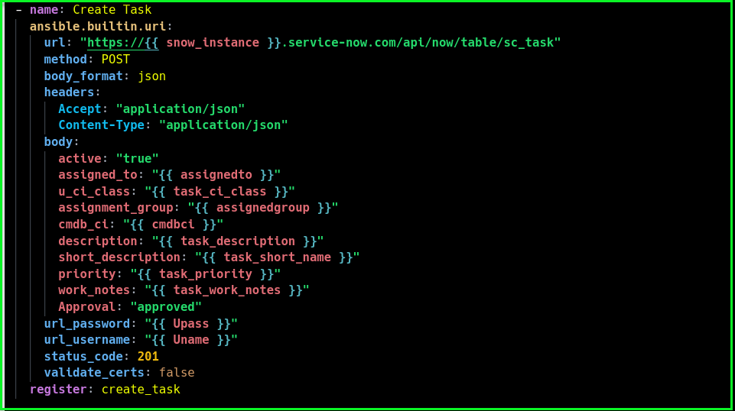
ServiceNow – uri create task
Demystifying ServiceNow
1

Slide 30
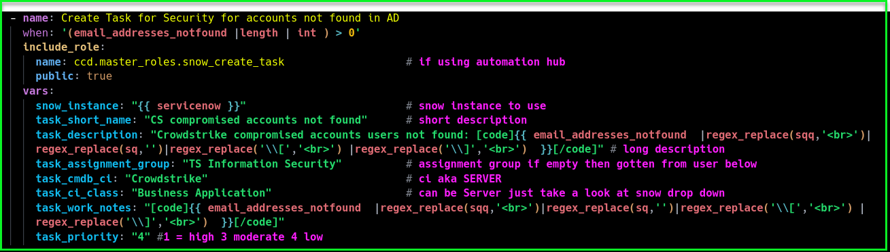
ServiceNow – Make is a role in your collection
Demystifying ServiceNow
1
2
3
4
5
6
7
8

Slide 31
Hailaeos.Troy@DenverGov.org

